Slide 1
Battlebots
Daphne Gijsbers, Daan van den Brink, Jeroen Schonkeren,
Lowie Versleijen

Slide 2
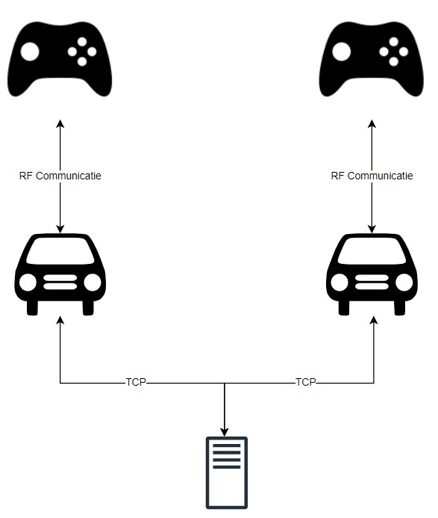
Concept
2 Battlebots
Controller
Server

Slide 3
Questions?

